Slide 1
Isometric Projection

Slide 2
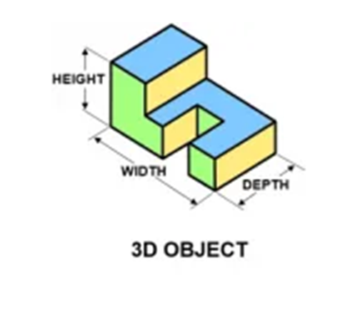
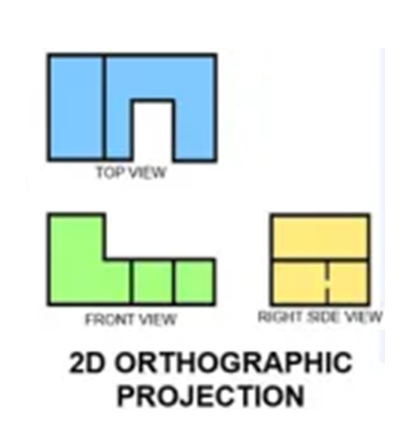

Isometric projection is a method for visually representing three-dimensional objects in two dimensions in technical and engineering drawings.

Slide 3
Isometric Axis :
Z-axis
Bounding Box for 3D object
X-axis
Y-axis
30^{O}
30^{O}

Slide 4
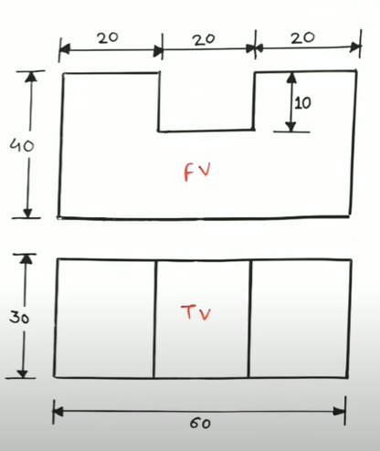
FRONT VIEW
SIDE VIEW
45^{O}
20 mm
10mm
20 mm
TOP VIEW
10mm
20 mm
30 mm
40mm
60 mm
30^{O}
30^{O}

Slide 5
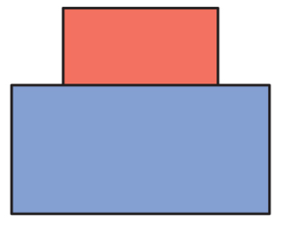
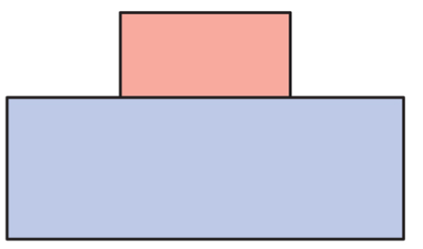
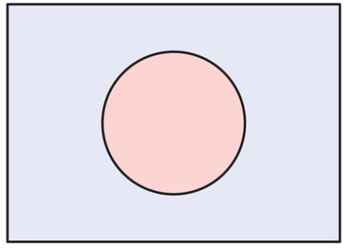
FRONT VIEW
SIDE VIEW
10 mm
20 mm
40 mm
40 mm
45^{O}
R =20mm
60 mm
TOP VIEW

Slide 6
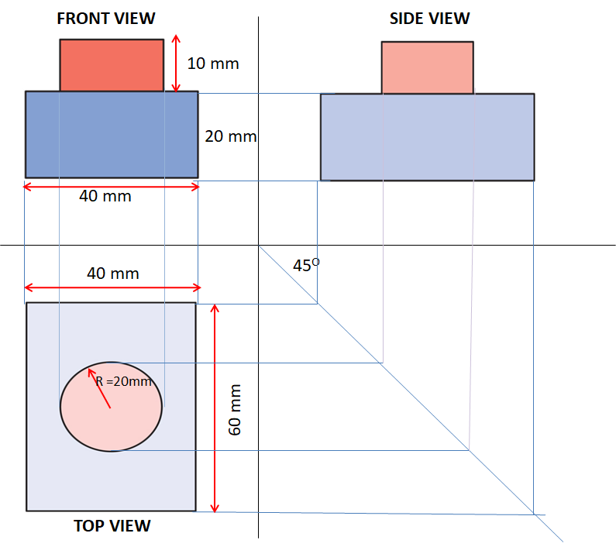
Draw front view with dark visible lines
60 mm
40 mm
30^{O}
30^{O}

